Slide 1
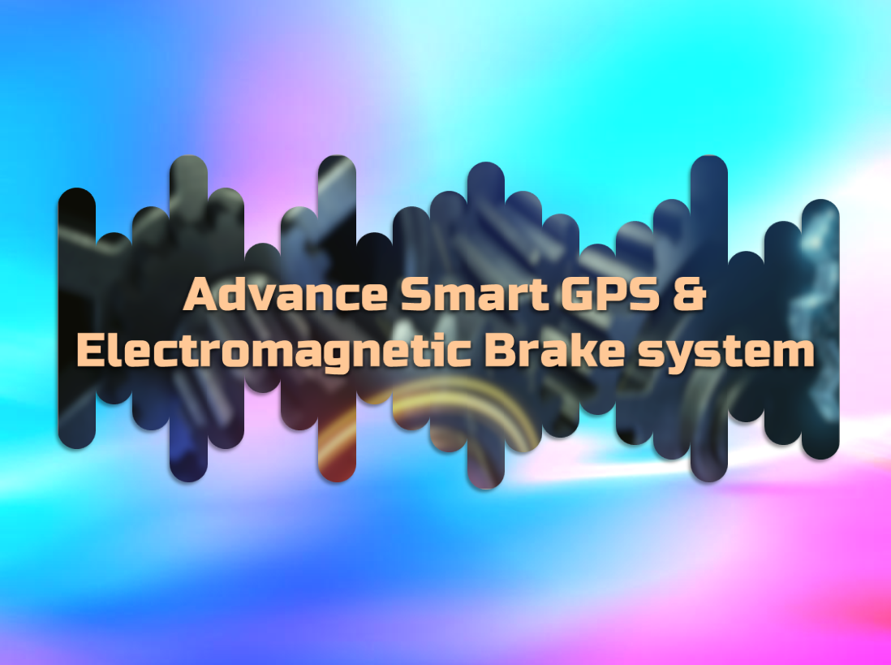

Slide 2

TEAM MEMBER :
1. M. Syed Nihaal Ahmed (17604231) [CEO/FOUNDER - Dread Eye Studio]
2. T. Rakest (16604252)
3. S. Sarath (170604233)
4. A. Syed Dastageer (17604248)
GUIDED BY :
Dr. S. Sivaganesan (Ass. HOD)

Slide 3
ABSTRACT :
Rising incidents of theft vehicles is an increasing concern in cities. The purpose of this project is to eliminate all possibility of theft by using ‘Advance Smart GPS System’. ‘Electromagnetic Brake Systems’ are the future of transportation safety using ‘Eddy Current Law’. Eddy current braking systems are a better alternative, to the currently used friction based braking systems for instance disk and drum brakes. Electromagnetic brakes have become a wide regarded, technological advancement, in regards to the reduction of friction and heat energy produced, when braking heavy loads of matter. By Combining ‘Advance Smart GPS’ & ‘Electromagnetic Brake System’ technology can get all the stats of these two system into mobile by creating a Mobile App. These System can be controlled from Mobile app, Smart GPS System is a system in which can integrate all vehicles into one app to track data and analyze from different place regardless of vehicles location. This Smart GPS System Project is copyrighted (©) by ‘Dread Eye Studio’. This project definitively answers the question regarding elimination of theft & future proof. Further studies are needed to establish crucial for safety & preventative measures.

Slide 4
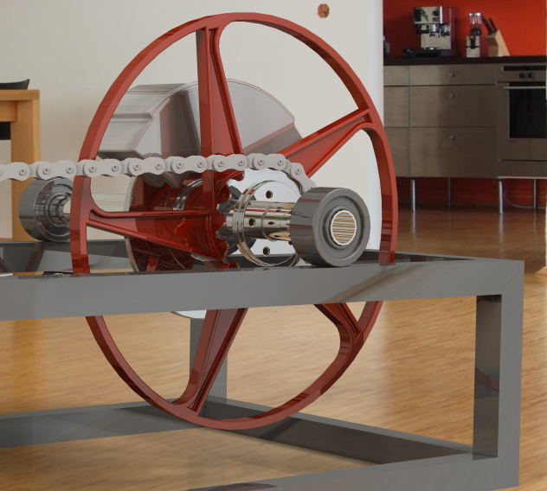
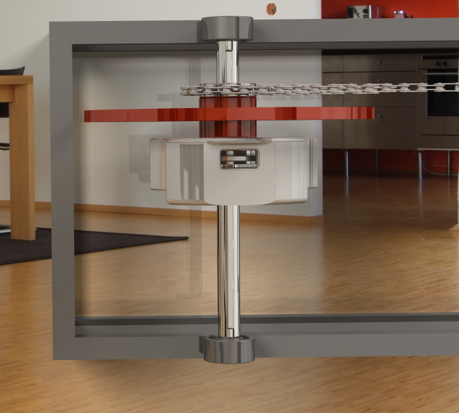
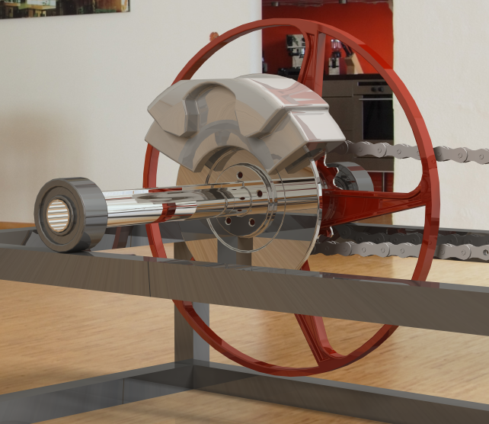
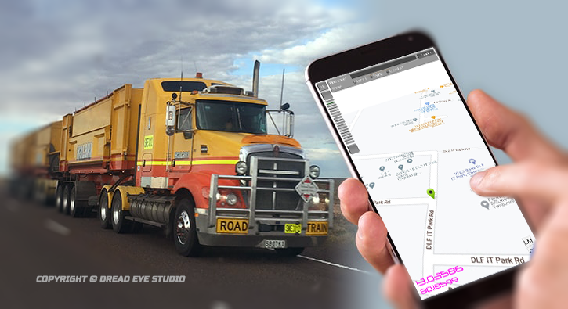
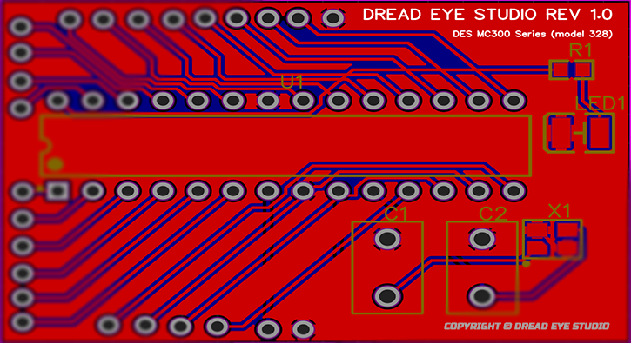
Design of 3D Product :

Slide 5
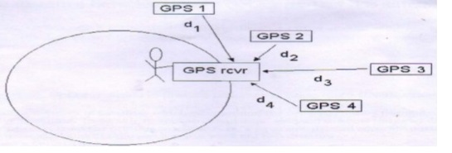
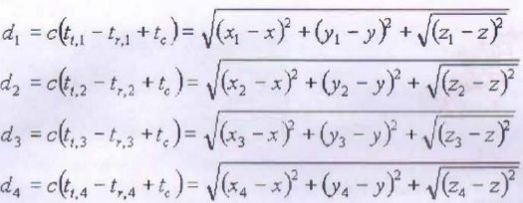
CALCULATION OFADVANCE SMART GPS SYSTEM :
The GPS calculation uses four equation with four unknowns x, y, z, t_{c} :

Slide 6
CALCULATION OF ELECTROMAGNETIC BRAKE SYSTEM :
The EBS calculation are as follows :
Calculating magnetic field (B):
F = [B²A/2µ_{o}] - {µ_{o} = [4π x 10⁻⁷ H.m⁻¹]}
Total magnetic flux in core (Ø):
Ø = B ×A
The Magnetizing force (H):
H = B/µ_{o}
Calculating total force (N):
F = [(NxI)²µ_{o}a / (2xg)] = [(NxI)²µ_{o}a / (2G₁)]
Motor torque (P):
P = [2πNT/60]
Calculating velocity for performance testing (V):
V = rὡ
Newton’s law of motion equation by acceleration (a):
V = u+at

Slide 7
INTRODUCTION OF ADVANCE SMART GPS SYSTEM :
The vehicle tracking system is a total security and fleet management solution.
Determine the location of a vehicle using different methods like GPS and other navigation system operating via satellite and ground based stations.
The vehicle tracking system is fitted inside the car that provides effective real time location and data can even be stored and downloaded to a computer which can be used for analysis in future.
The vehicle unit incorporates the hardware part that is the DES MC300 Series (model 328), GPS and GSM modem kept inside the vehicle that is to be tracked.
Closely monitor vehicle in real time as well as to check the history of vehicles movements.

Slide 8
HISTORY OF ADVANCE SMART GPS SYSTEM :
Global Positioning Systems (GPS) were designed by the United States Government and military, which the design was intended to be used as surveillance.
Primarily used for navigation purposes. At that time, the GPS project cost approximately $12 billion for the design and launch of 18 satellites, six in each of the orbital planes spaced 120 degrees apart, and their ground stations.
It was used by military and intelligence organizational during the Cold War, the Soviet-launched spacecraft Sputnik. Since its introduction in the 1960s, GPS has developed into a larger and more advanced satellite network constellation that orbits Earth at fixed points in space to send signals to anyone with a GPS receiver.
The signals carry a time code and geographic data point that enables us to display a devices exact position anywhere on the planet.
They realized that since they knew their exact location on the globe, by measuring the Doppler distortion it was possible to pinpoint where the satellite was along its orbit.

Slide 9
INTRODUCTION OF ELECTROMAGNETIC BRAKE SYSTEM :
The principle of braking is depending on the conversion of energy that is converted kinetic energy into thermal energy form of heat.
In two wheeler Disc brake and Drum brake are used in existing system, both braking are contact type braking as well as the frictional resistance braking.
Eddy current braking systems are a better alternative to the currently used friction based braking systems for instance disk and drum brakes.
Electromagnetic brakes are the brakes working on the electric power and magnetic power. They work on the principle of electromagnetism.
The original name was ‘Electro Mechanical Brakes’ but over the years the name changed to ‘Electromagnetic Brakes’.

Slide 10
HISTORY OF ELECTROMAGNETIC BRAKE SYSTEM :
It is found that electromagnetic brakes can develop a negative power which represents nearly twice the maximum power output of a typical engine, and at least three times the braking power of an exhaust brake.
The brake linings would last considerably longer before requiring maintenance and the potentially brake fade problem could be avoided. In research conducted by a truck manufacturer, it was proved that the electromagnetic brake assumed 80% of the duty which would otherwise have been demanded of the regular service brake.
It relay on the efficiency of engine components for its use, so do exhaust and hydrokinetic brakes. The exhaust brake is an on/off device and hydrokinetic brakes have very complex control system.
The electromagnetic brake control system is an electric switching system which gives it superior controllability.
The installation of an electromagnetic brake is not very difficult if there is enough space between the gearbox and the rear axle.

Slide 11
LITERATURE REVIEW OF ADVANCE SMART GPS SYSTEM :
Nowadays GPS units are great tracking devices that help fleet managers stay in control of their business. The applications in today’s GPS units make it possible to take full control of any company.
GPS based vehicle navigation system is implemented. This is done by fetching the information of the vehicle like location, distance, etc by using GPS and GSM.
Then this periodic information of location is transmitted to monitoring or tracking server. This transmitted information is displayed on the display unit by using the DES Global Map to display the vehicle location in the electronic DES Global Map.
This system can be used in the monitoring our car. This system uses microcontroller powered by DES MC300 Series (model 328), Global Positioning System (GPS) and Global System for Mobile Communication (GSM).

Slide 12
ACTIVE AND PASSIVE TRACKING SYSTEM :
Tracking System is classified as ‘passive’ and ‘active’. Passive devices store GPS location, speed, heading and also track information like trigger event for key press, door open or close.
Once the vehicle returns to a predetermined point, the device is removed or using WIFI/BLUTOOTH etc to transfer data which then analysis with computer. Were as Active devices also collect same data as passive the only difference is it does in real time via cellular or WIFI over Internet.
Passive trackers do not monitor movement in real time.
The main reason people choose passive trackers is that these devices are less expensive than active trackers. GPS passive device are not attached to a monthly fee, which makes there trackers affordable.

Slide 13
TYPE OF TRACKING SYSTEM :
There are three main types of GPS vehicle tracking that are widely used. There are:
Assisted Global Positioning System (AGPS)
Automatic Vehicle Location (AVL) system
Radio Frequency Identification (RFID)

Slide 14
ASSISTED GLOBAL POSITION SYSTEM (AGPS) :
In AGPS system, a terrestrial RF network is used to improve the performance of GPS receivers as it provides information about the satellite constellation directly to the GPS receivers.
AGPS uses both mobiles and cellular networks to locate the accurate positioning information.
Location of the vehicle is provided with accuracy of between 3m and 8m, and the speed of 1Km by using this method.
The system provides continues updates after every 10 seconds while the vehicle is in motion.

Slide 15
AUTOMATIC VEHICLE LOCATION SYSTEM (AVL) :
AVL comprises of Global Positioning System (GPS) and Geographic Information System (GIS) in order to provide the real geographic location of the vehicle.
AVL system consists of PC based tracking software to dispatch, a radio system.
The system also has some limitation using the AVL system we cannot get accurate, complete and sufficient satellite data in dense urban areas or indoors and when transmission is blocked by natural obstructions or many buildings.
It can also occur in RF shadowed environments and under unfriendly Radio Frequency (RF) conditions. Sometimes, a position fix can be impossible.

Slide 16
RADIO FREQUENCY IDENTICATION (RFID) :
In RFID is an automatic identification method using devices called tags to store and remotely retrieves data. RFID uses radio waves to capture data from tags.
The tracking method of RFID is comprised of three components tag passive, semi passive and active, reader (antenna or integrator) and software. RFID tag which contains microelectronic circuits sends the vehicle information to a remote RFID reader which is then read via the software.
This system provides the location of the vehicle with the accuracy of 4m to 6m. Information such as location of the vehicle, mileage and speed are delivered by the tracking system to the centre.
The information is updated every one minute. The information is sent to and received from RFID tags by a reader using radio waves.

Slide 17
LITERATURE REVIEW OF ELECTROMAGNETIC BRAKE SYSTEM :
Principle of Electromagnetic Brake System
If a piece of copper wire wound around the nail bar and then connected to the electrical supply, it would create that substance to act as an electro magnet.
The magnetic field that is generated in the wire, from the current is known as “Right Hand Thumb Rule”. The magnetic fields disappear when the current is lost.
Working of Electromagnetic Brake System
A soft iron core that is magnetized by passing a current through a coil of wire wound on the core.
Electromagnets are used to lift heavy masses of magnetic material.

Slide 18
TYPES OF CLASSIFICATION OF ELECTROMAGNETS :
Traction Magnets:
In which the pull is to be exerted over a distance and work is done by reducing the air gap.
Lifting or holding magnets:
In which the material is initially placed in contact with the magnet For Examples of the latter type are magnetic chucks and circular lifting magnets.

Slide 19
DESIGN AND PRACTICAL WORKING :
Theoretically, it is divided into three main units are Base unit, Driving unity and Braking Unit.
Base unit consist of structural foundation of base unit, driving unit consist of an electrical motor, power control and bearing. Braking unit consists of an electromagnet.
Electromagnetic brakes also called as Electro Mechanical Brakes. Stop motion using electromagnetic force to apply mechanical resistance by friction. The original name was ‘Electro Mechanical Brakes’ referring to their actuation method.
Since becoming popular in the mid 20th century especially in trains and trolleys, the variety of application and brake current brakes use electromagnetic force but electromagnetic brakes ultimately depend on friction and eddy current brakes use magnetic force directly.

Slide 20
MATERIAL SELECTION :
Material Selection process is depending on application of where the brake is used.
Generally plate is mostly used in aluminum because it is very efficient to produce eddy current in plate.
Preferred to use most effective copper plate but it is not cost efficient.

Slide 21
TYPE OF BRAKE SYSTEM :
There are three main types of brake system are:
Electromagnetic Brake System:
Frictional Brake System:
Hydraulic brake system:

Slide 22
ELECTROMAGNETIC BRAKE SYSTEM :
Rising style of brake system, electromagnetic brakes use an electric motor that is included in the automobile which help the vehicle come to stop.
These types of brakes are in most hybrid vehicles and use an electric motor to charge the batteries and regenerative brakes.
On occasion some buses will use it as a secondary retarder brake.

Slide 23
FRICTIONAL BRAKE SYSTEM :
Frictional brake system is found in many automobiles. It is typically found in two forms pads and shoes.
As the name implies these brakes use friction to stop the automobile from moving.
Alternatively on a drum brake, a rotating drum with shoes will expand and rub against the inside of the drum.

Slide 24
HYDRAULIC BRAKE SYSTEM :
Hydraulic brake system is composed of a master cylinder that is fed by a reservoir of hydraulic braking fluid.
This is connected by an assortment of metal pipes and rubber fittings which are attached to the cylinders of the wheels.
The wheels contain two opposite pistons which are located on the band or drum brakes which pressure to push the pistons apart forcing the brake pads into the cylinders, thus causing the wheel to stop moving.

Slide 25
SIGNIFICATION/SCOPES OF ELECTROMAGNETIC BRAKE SYSTEM :
Electromagnetic brakes satisfy all the energy requirements of braking without the use of friction.
These brake component cost is less so these brakes are cheap.
They can be used as an alternative method for the future crisis of the crude oils.

Slide 26
LIMITATION OF ELECTROMAGNETIC BRAKE SYSTEM :
The installation of an electromagnetic brake is very difficult if there is not enough space between the gearbox and rear axle.
It cannot use grease or oil.
Electromagnetic brakes are good at slowing things down, not completely stopping them.

Slide 27
THANK YOU

